Slide 1
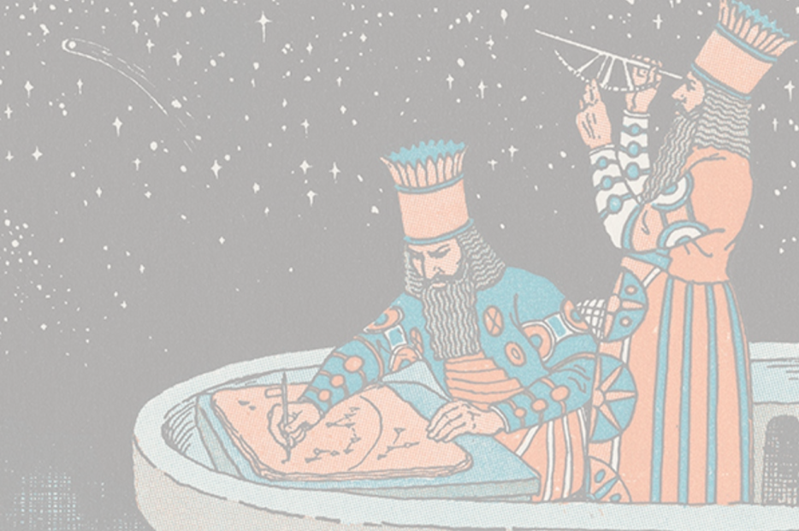
12 CUNG
HOÀNG ĐẠO
Nhóm 14 – Công nghệ truyền thông đa phương tiện

Slide 2
12 CUNG
HOÀNG ĐẠO
NGUỒN GỐC

Slide 3

NGUỒN GỐC

Slide 4


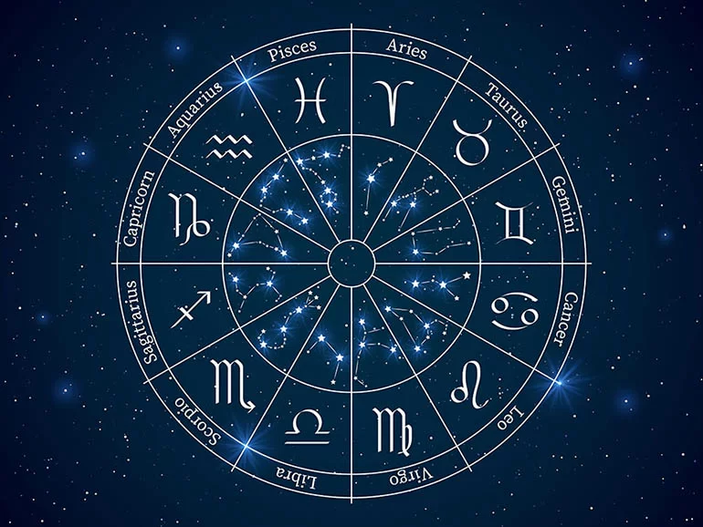










NGUỒN GỐC

Slide 5
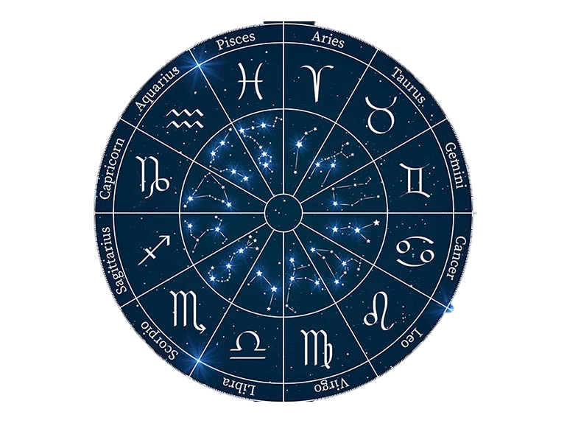
NGUỒN GỐC

Slide 6

NGUỒN GỐC

Slide 7
NGUỒN GỐC

Slide 8
NGUỒN GỐC

Slide 9
Aries
Date
Mar 21 – Apr 19
Aries Traits
Eager, dynamic quick
and competitive

Slide 11
Taurus
Date
Apr 20 – Mar 20
Taurus Traits
Strong, dependable,
sensual and creative

Slide 13

Gemini
Date
May 21 – Jun 20
Gemini Traits
Versatile, expressive,
curious and kind

Slide 15
Cancer
Date
Jun 21 – Jul 22
Cancer Traits
Intuitive, sentimental,
compassionate
and protective

Slide 17
Leo
Date
Jul 23 – Aug 22
Leo Traits
Dramatic, outgoing
Fiery and self-assured

Slide 19
Virgo
Date
Aug 23 – Sep 22
Virgo Traits
Practical, loyal,
gentle and analytical

Slide 21
Libra
Date
Sep 23 – Oct 22
Libra Traits
Social, fair-minded,
diplomatic and gracious

Slide 23
Scorpio
Date
Oct 23 – Nov 21
Scorpio Traits
Passionate, stubborn,
Resourcefull and brave

Slide 25
Sagittarius
Date
Nov 22 – Dec 21
Traits
Extroverted, optimistic,
funny and generous

Slide 27
Capricorn
Date
Dec 22 – Jan 19
Capricorn Traits
Serious, independent,
discriplined
and tenacious

Slide 29
Aquarius
Date
Jan 20 – Feb 18
Aquarius Traits
Deep, imaginative,
original
and uncompromising

Slide 31
Pises
Date
Feb 19 – Mar 20
Pises Traits
Affectionate, empathetic,
wise and artistic

Slide 32
NGUỒN GỐC

Slide 33

SUMMARY

Slide 34
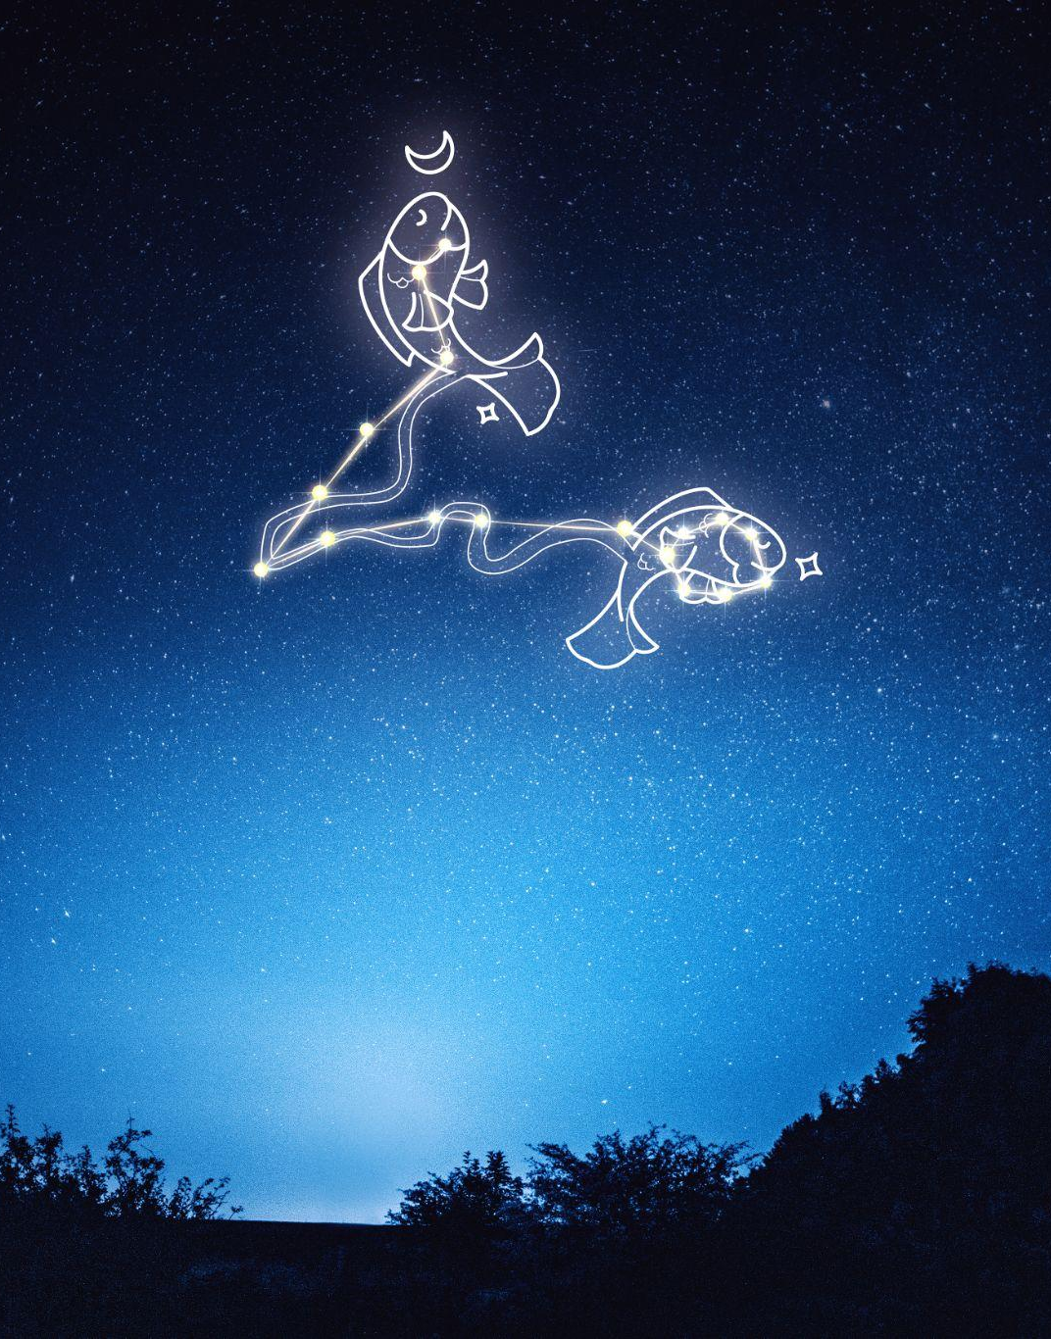
Thanks for watching !
Bùi Duy Thông 19522299
Nguyễn Duy Trọng Nhân 20520669
Mai Phước Sang 20520735
Nguyễn Văn Đức Ngọc 20521666

Slide 35


